Slide 1


Image Style Transfer, Neural Doodles & Texture Synthesis
Dmitry Ulyanov
Russian Supercomputing Days
Moscow, 2016

Slide 2
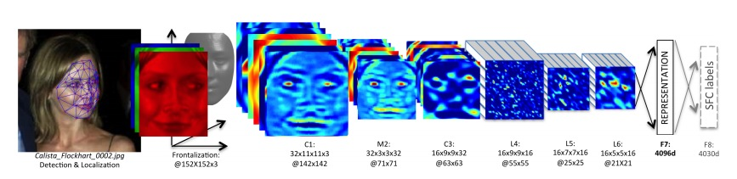
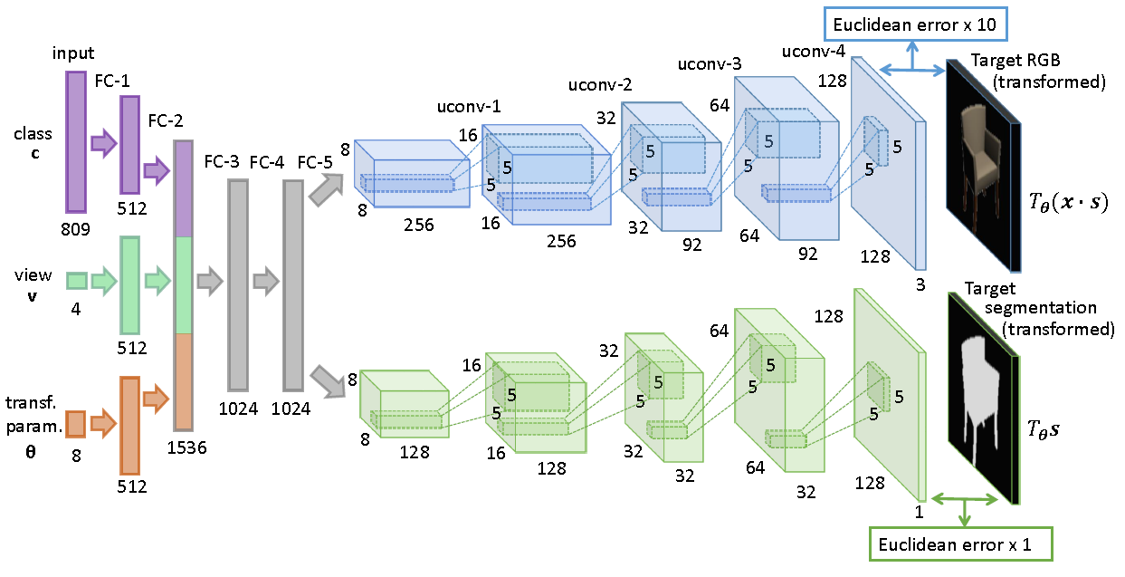
Neural networks
Facebook DeepFace (2014)
Dosovitsky et. al. (2015)
Notes:
Change the caption for mahendran, probably add выделяшки
====
One recent realization is that pre-trained deep convolutional neural network can be used to create fascinating images and visualizations.
For example, one possibility is to maximize selected neural activations in order to generate neural dreams of objects or [click] other patterns.
Most importantly for us, [click] CNNs were recently used to capture the style of an image or texture [click] in order to create either new texture samples or to transfer style from one image onto another. The texture synthesis and style transfer is what we will focus on.

Slide 3
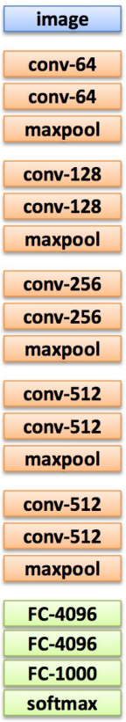
VGG-style networks
Consist of repeated
Convolutions
ReLU
MaxPool
+
FC + Softmax at the end
Activations (feature maps)
Tensor of size CxWxH
H
C
W
Image credit: Xavier Giro, DeepFix slides
Notes:
Change the caption for mahendran, probably add выделяшки
====
One recent realization is that pre-trained deep convolutional neural network can be used to create fascinating images and visualizations.
For example, one possibility is to maximize selected neural activations in order to generate neural dreams of objects or [click] other patterns.
Most importantly for us, [click] CNNs were recently used to capture the style of an image or texture [click] in order to create either new texture samples or to transfer style from one image onto another. The texture synthesis and style transfer is what we will focus on.

Slide 4
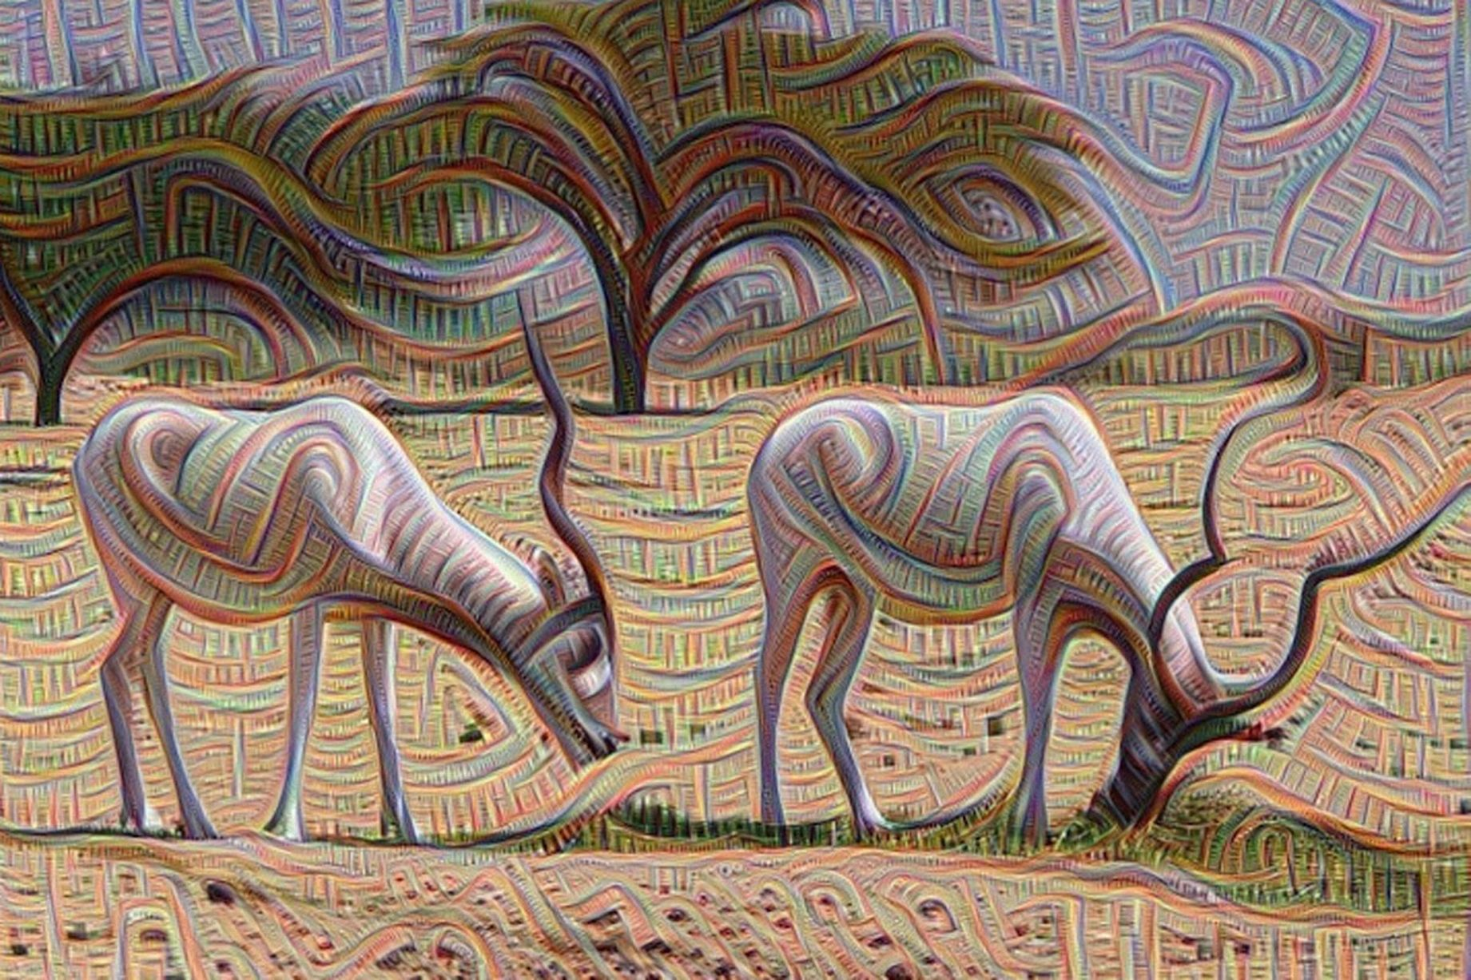
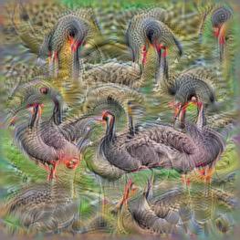
Image generation examples
Mordvintsev, 2015
Simonyan et al. 2014
Notes:
Change the caption for mahendran, probably add выделяшки
====
One recent realization is that pre-trained deep convolutional neural network can be used to create fascinating images and visualizations.
For example, one possibility is to maximize selected neural activations in order to generate neural dreams of objects or [click] other patterns.
Most importantly for us, [click] CNNs were recently used to capture the style of an image or texture [click] in order to create either new texture samples or to transfer style from one image onto another. The texture synthesis and style transfer is what we will focus on.

Slide 5
Presentation structure
General overview:
Texture synthesis
Image style transfer
Neural doodles
Our work “Texture networks” (ICML 2016):
Fast texture synthesis
Fast image style transfer
Fast neural doodles
Notes:
One recent realization is that pre-trained deep convolutional neural network can be used to create fascinating images and visualizations.
For example, one possibility is to maximize selected neural activations in order to generate neural dreams of objects or [click] other patterns.
Most importantly for us, [click] CNNs were recently used to capture the style of an image or texture [click] in order to create either new texture samples or to transfer style from one image onto another. The texture synthesis and style transfer is what we will focus on.

Slide 6
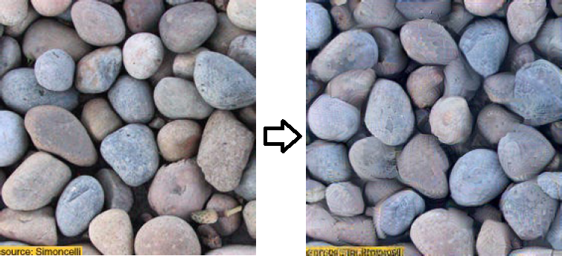
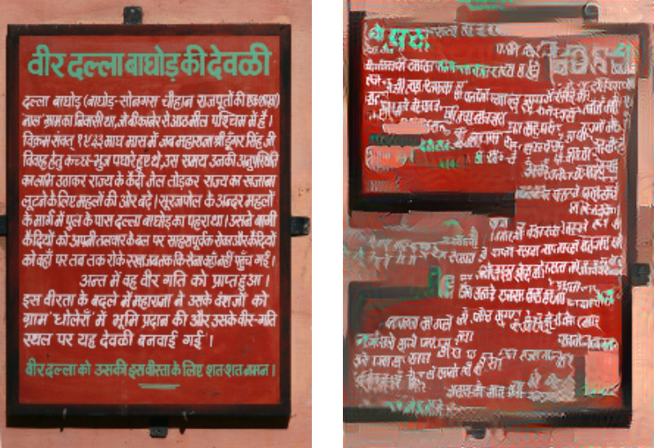
Examples: Texture Synthesis
Source Synthesized
L. A. Gatys, A. S. Ecker, M. Bethge; “Texture Synthesis Using Convolutional Neural Networks“; NIPS 2015
Notes:
What is a texture ? Preserve local structure
Most importantly for us, [click] CNNs were recently used to capture the style of an image or texture [click] in order to create either new texture samples or to transfer style from one image onto another. The texture synthesis and style transfer is what we will focus on.

Slide 7
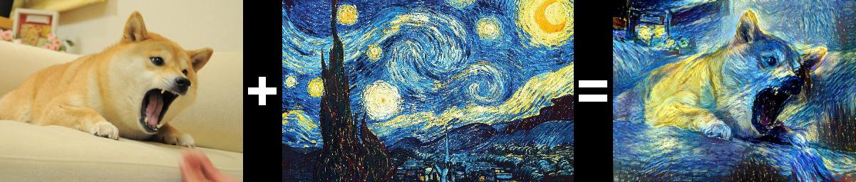
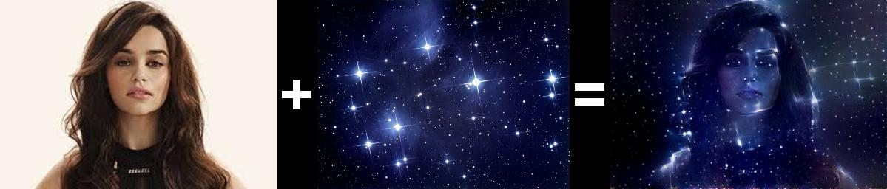
Examples: Image Artistic Style Transfer
Content Style Result
L. A. Gatys, A. S. Ecker, M. Bethge; “Image Style Transfer Using Convolutional Neural Networks“; CVPR 2016
Notes:
Change the caption for mahendran, probably add выделяшки
====
One recent realization is that pre-trained deep convolutional neural network can be used to create fascinating images and visualizations.
For example, one possibility is to maximize selected neural activations in order to generate neural dreams of objects or [click] other patterns.
Most importantly for us, [click] CNNs were recently used to capture the style of an image or texture [click] in order to create either new texture samples or to transfer style from one image onto another. The texture synthesis and style transfer is what we will focus on.

Slide 8
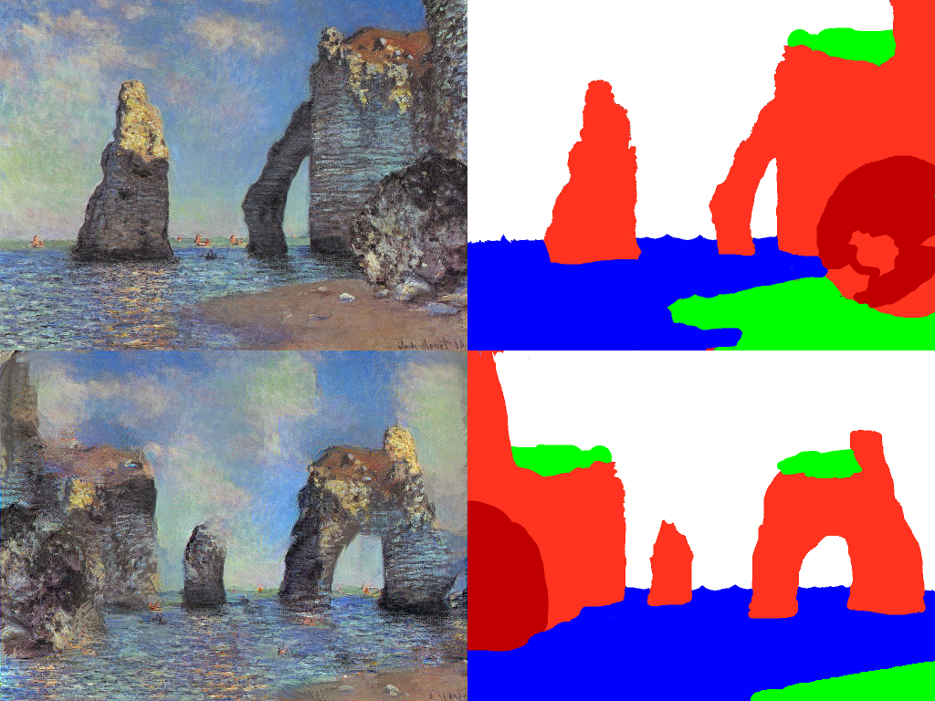
Examples: Neural Doodles
Template Mask
Synthesized image User mask
A. J. Champandard. “Semantic Style Transfer and Turning Two-Bit Doodles into Fine Artworks”, 2016
Notes:
Change the caption for mahendran, probably add выделяшки
====
One recent realization is that pre-trained deep convolutional neural network can be used to create fascinating images and visualizations.
For example, one possibility is to maximize selected neural activations in order to generate neural dreams of objects or [click] other patterns.
Most importantly for us, [click] CNNs were recently used to capture the style of an image or texture [click] in order to create either new texture samples or to transfer style from one image onto another. The texture synthesis and style transfer is what we will focus on.

Slide 9
How does it work?
Notes:
Change the caption for mahendran, probably add выделяшки
====
One recent realization is that pre-trained deep convolutional neural network can be used to create fascinating images and visualizations.
For example, one possibility is to maximize selected neural activations in order to generate neural dreams of objects or [click] other patterns.
Most importantly for us, [click] CNNs were recently used to capture the style of an image or texture [click] in order to create either new texture samples or to transfer style from one image onto another. The texture synthesis and style transfer is what we will focus on.

Slide 10
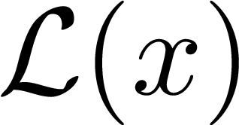
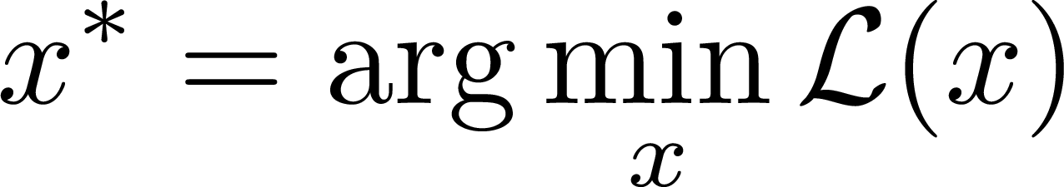
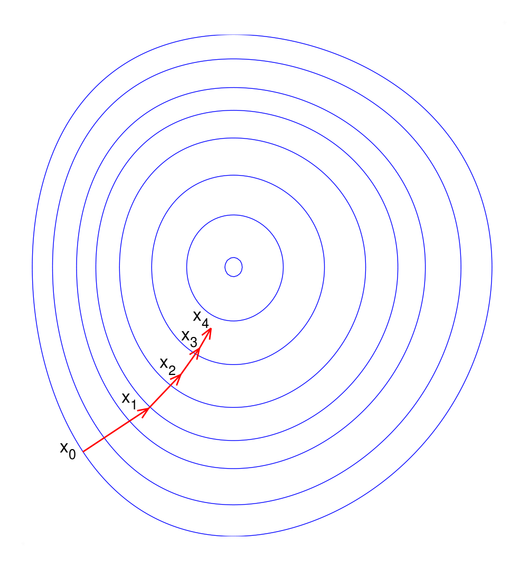
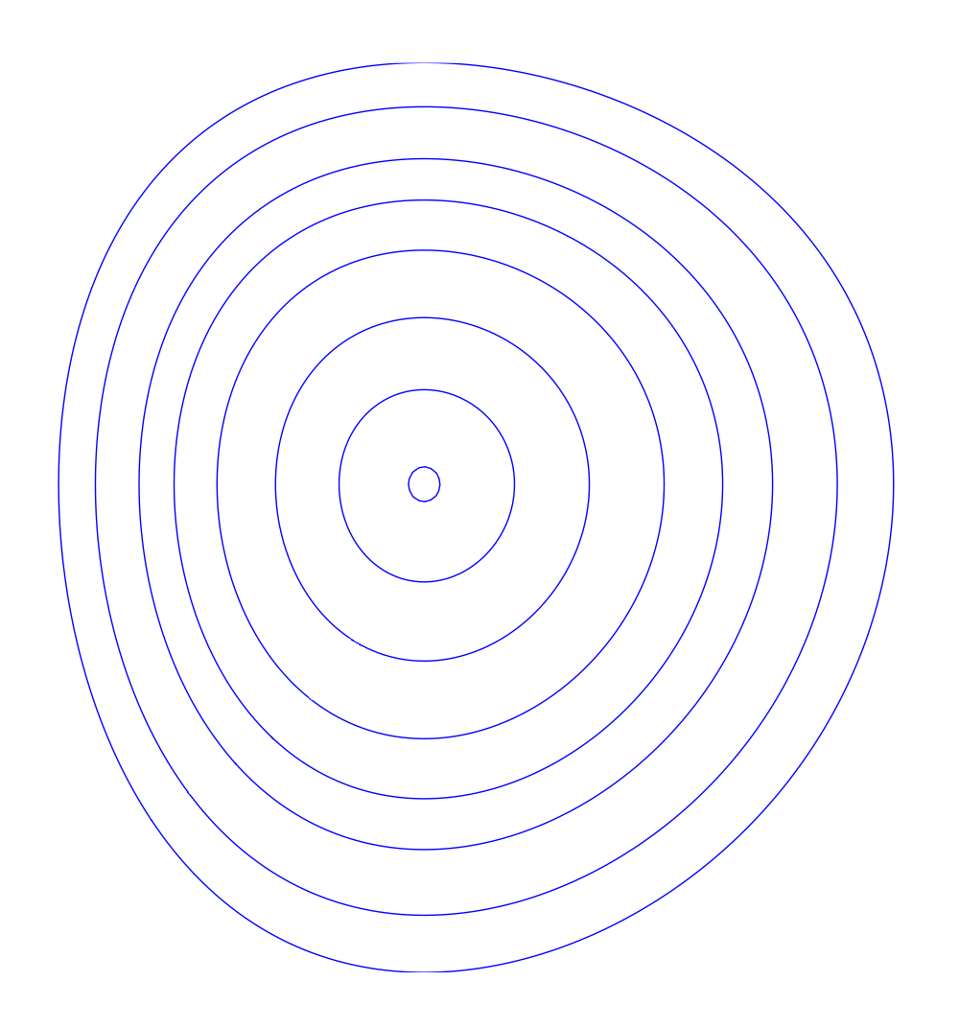
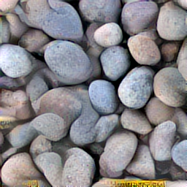
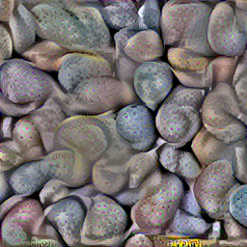
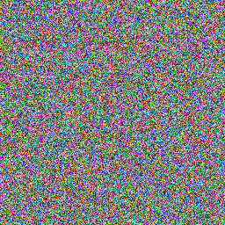
Image generation by optimization
Notes:
How the generation is usually performed? First, you need to come up with a loss function, lets call it L(x) [click], which can score an arbitrary image and tell how close this image is to a desired one.
In fact, given one such loss, you can use that to generate images though a process of optimization. [click]
That is, you start with random noise x0 and you gradually optimize it in order to obtain an image x* that minimizes the loss L.
So the only question is how to define the loss function to solve your problem.

Slide 11
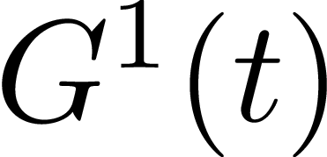
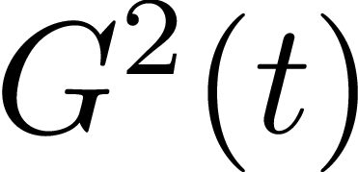
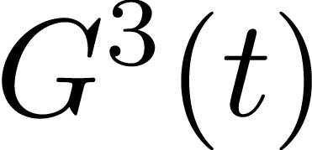

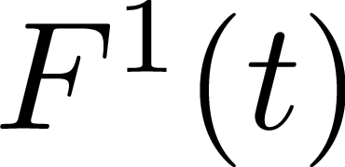
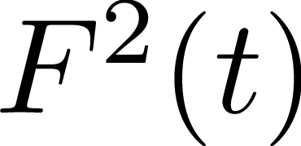
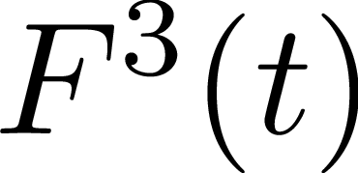

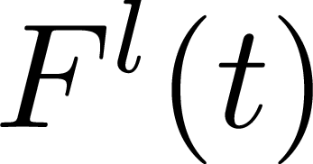
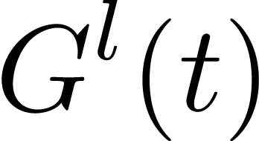
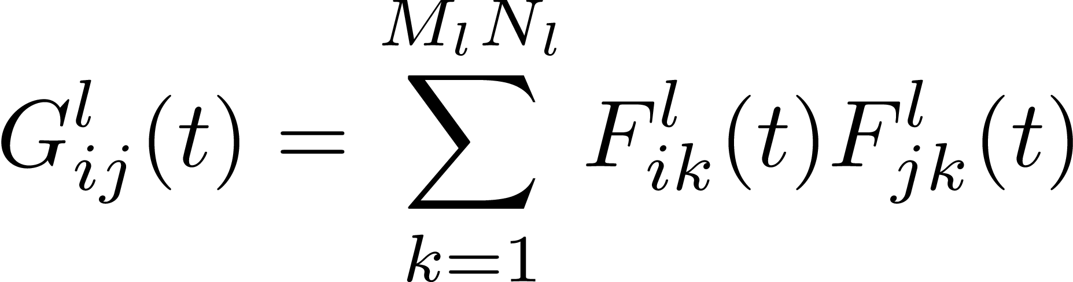
Gatys et. al.: Optimization-based texture synthesis
Texture:
Activations at layer :
Gram matrix at layer :
Notes:
Make the diagram from top to bottom, probably formulas on the right
====
Having a texture example T you can feed it into VGG-19 network and [click] obtain the activations at the specific layers. For each layer you can compute a [click] feature maps correlation matrix, usually called Gram matix and store it.

Slide 12
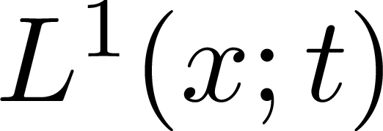
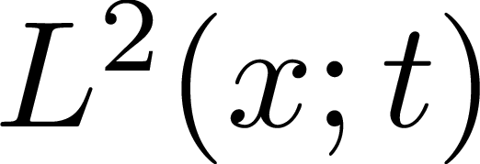
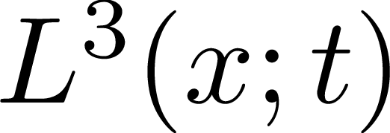

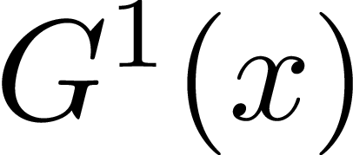
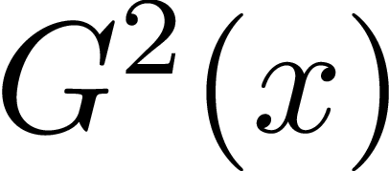
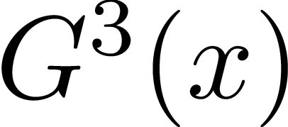
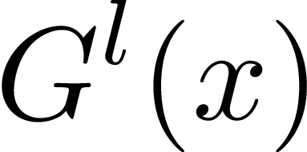
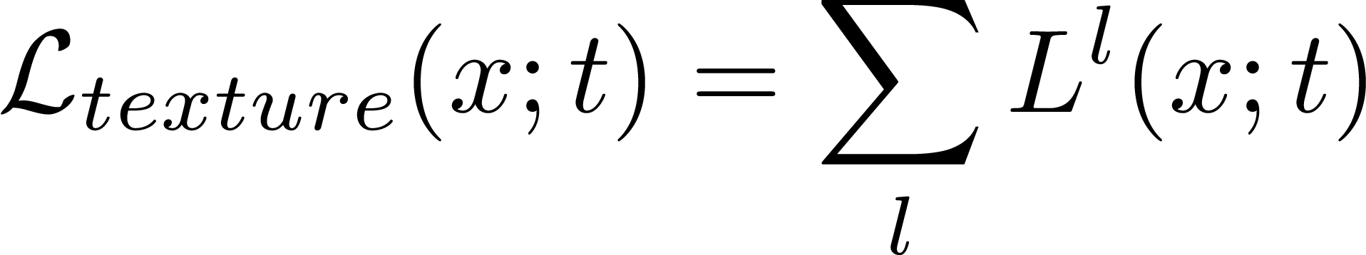
Gatys et. al.: Optimization-based texture synthesis
Image:
Gram matrix at layer :
Loss at layer :
Notes:
Probably connect to the previous one , e.g. show the descriptor network on the bottom
===
Then to generate a new sample X you initialize X with noize, feed it to network, obtain the correlation matrices G and compare them to stored gram matrices of the texture.
Finally the texture loss is composed as a sum of individual losses at each layer.

Slide 13
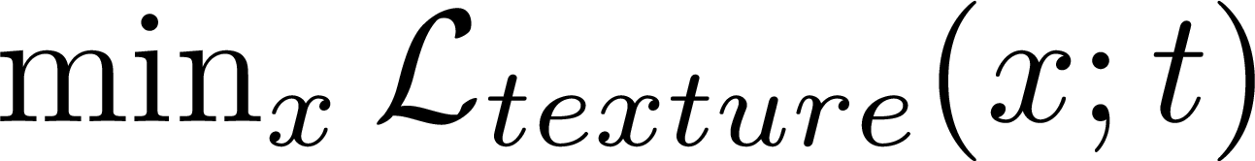
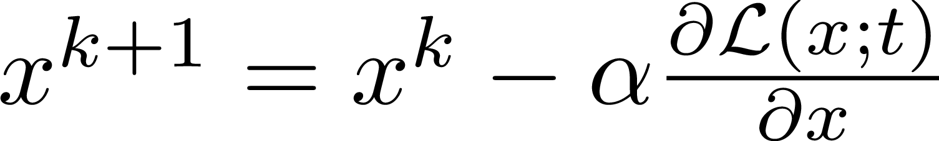
Gatys et. al.: Optimization-based texture synthesis
Loss:
Solve
By gradient descent
Notes:
Refactor according to the previous ones
====
Having the loss defined one can solve [click] an optimization task with some gradient method [click] since the loss is fully differentiable, and eventually get a texture sample.

Slide 14
Examples: Texture Synthesis
Source Synthesized
L. A. Gatys, A. S. Ecker, M. Bethge; “Texture Synthesis Using Convolutional Neural Networks“; NIPS 2015
Notes:
What is a texture ? Preserve local structure
Most importantly for us, [click] CNNs were recently used to capture the style of an image or texture [click] in order to create either new texture samples or to transfer style from one image onto another. The texture synthesis and style transfer is what we will focus on.

Slide 15
How to: Neural Doodles
Template Mask
Synthesized image User mask
github.com/DmitryUlyanov/fast-neural-doodle
Notes:
Change the caption for mahendran, probably add выделяшки
====
One recent realization is that pre-trained deep convolutional neural network can be used to create fascinating images and visualizations.
For example, one possibility is to maximize selected neural activations in order to generate neural dreams of objects or [click] other patterns.
Most importantly for us, [click] CNNs were recently used to capture the style of an image or texture [click] in order to create either new texture samples or to transfer style from one image onto another. The texture synthesis and style transfer is what we will focus on.

Slide 16


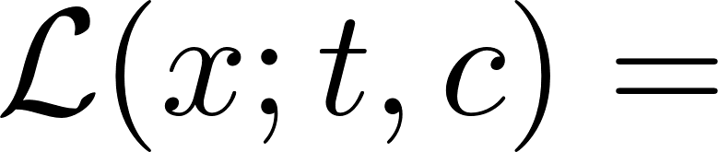
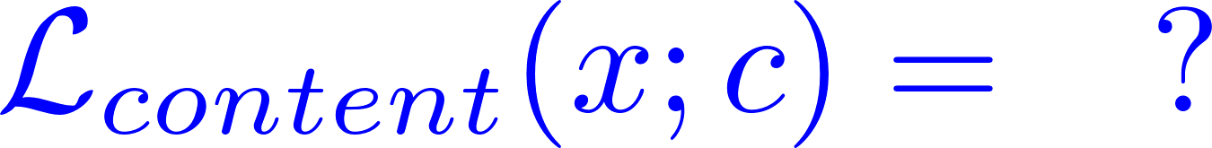
Gatys et. al.: Content loss for style transfer
Content Style Result
Total loss:
Texture loss:
Content loss:
Notes:
Make the diagram from top to bottom, probably formulas on the right
====
Having a texture example T you can feed it into VGG-19 network and [click] obtain the activations at the specific layers. For each layer you can compute a [click] feature maps correlation matrix, usually called Gram matix and store it.

Slide 17
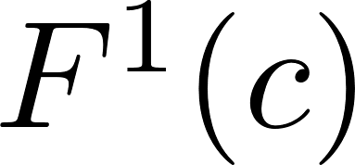
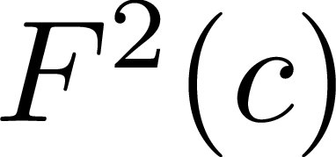
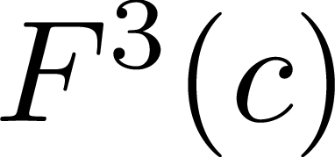
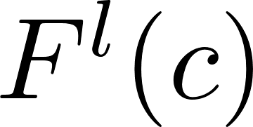
Gatys et. al.: Content loss for style transfer
Content image:
Activations at layer :
Notes:
Make the diagram from top to bottom, probably formulas on the right
====
Having a texture example T you can feed it into VGG-19 network and [click] obtain the activations at the specific layers. For each layer you can compute a [click] feature maps correlation matrix, usually called Gram matix and store it.

Slide 18
Gatys et. al.: Content loss for style transfer
Content Style Result
Total loss:
Texture loss:
Content loss:
Notes:
Make the diagram from top to bottom, probably formulas on the right
====
Having a texture example T you can feed it into VGG-19 network and [click] obtain the activations at the specific layers. For each layer you can compute a [click] feature maps correlation matrix, usually called Gram matix and store it.

Slide 19
What else?
The results are excellent, but…
It is slow! Several minutes on a high-end GPU.
Notes:
Make the diagram from top to bottom, probably formulas on the right
====
Having a texture example T you can feed it into VGG-19 network and [click] obtain the activations at the specific layers. For each layer you can compute a [click] feature maps correlation matrix, usually called Gram matix and store it.

Slide 20

Texture Networks: Feed-forward Synthesis of Textures and Stylized Images
Dmitry Ulyanov^{1,2}, Vadim Lebedev^{1,2}, Andrea Vedaldi³, Victor Lempitsky²
ICML 2016
¹
²
³

Slide 21
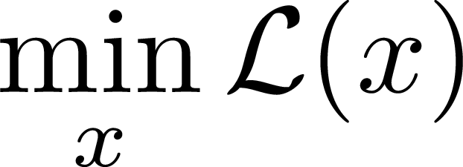
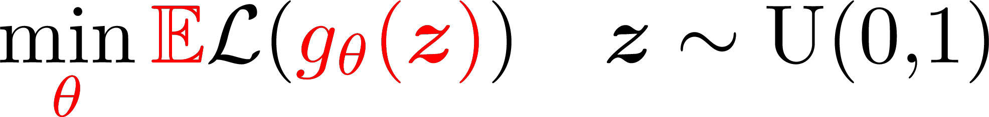
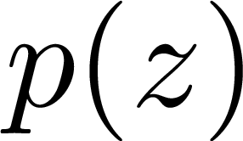

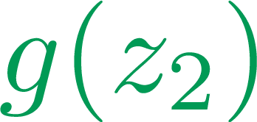
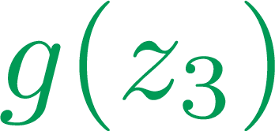

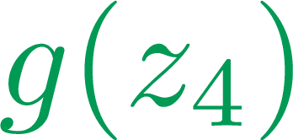

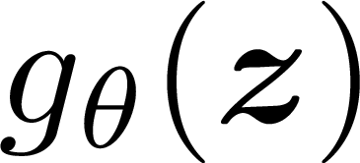
Our method: learn a neural net to generate
Instead of solving
Solve
Now
Generation requires a single evaluation
But
Need to make sure does not collapse everything into one point
Notes:
Add the animation. Have a full plot, show optimization examples. Then show on the same plot how generator works.
===
So, given an optimization problem, Instead of solving it, directly optimizing the image X, we propose to train a generator network G [click] to map noise samples into images with low loss value.
[click] That is, once the generator is trained the samples can be obtained almost immediately within a single pass of the network G.
[click] You may also notice, that this formulation allows generator to map any input to a single point. Thus a regularization of generator is required. ?????

Slide 22

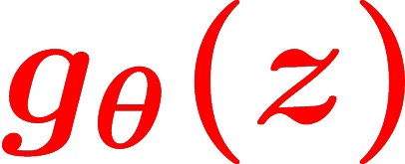

We propose: texture network
Solve
By gradient descent
Generate :
Notes:
SAMPLE X
===================
We propose to train a generator network G to produce texture samples directly by optimizing the weights THETA of the generarator.
[click] In fact, the loss function is differentiable with respect to the weights and any gradient method can be applied for empirical loss minimization.
During training time a minibatch of noise samples Z is drawn from a uniform distribution, the gradient is computed and weights THETA are updated iteratively. Note that descriptor network stays fixed.
[click] To sample a texture instance we only need to sample noize vector Z and evaluate the network G once.

Slide 23



We propose: stylization network
Solve
By gradient descent
Generate :
Notes:
Victor told to remove the gradient descent part
===
Next the input to generator is changed. For stylization we concatenate the noise sample with a content image [click] along depth dimension. Do now an input example has RGB channel along depth dimention and several channels filled with noise.
We draw a minibatch of examples from a huge collection of images while training.
Eventually network can stylize any image of any size.

Slide 24



Qualitative evaluation: textures
Texture
Gatys et. al.
(90 sec.)
Ours
(0.06 sec.)
Almost similar but ours 500 times faster.
Notes:
“Note that they are different”, write execution time.
====
We next evaluate qualitatively evaluate our results. [click]
The original texture is presented on the the picture.
[click] Next we present texture synthesized by an optimization-based method of Gatys et. al.
[click] And finally a single sample from a trained generator.

Slide 25



Qualitative evaluation: textures
Texture
Gatys et. al.
(90 sec.)
Ours
(0.06 sec.)
Notes:
The texture [click]
Optimization [click]
Ours

Slide 26

Qualitative evaluation: textures
Texture Gatys et. al. Ours Texture Gatys et. al. Ours
(90 sec.) (0.06 sec.) (90 sec.) (0.06 sec.)
Notes:
The results are pretty sim, but we are 500 times faster
==
More examples are presented on this slide.

Slide 27







Qualitative results: stylization
Content
Ours
(0.06 sec.)
Gatys et. al.
(90 sec.)
Style
Notes:
We present stylization results. The content image, [click] the style, [click] Gatys et. al. optimization based, and ours.

Slide 28




Qualitative results: stylization
Content
Style
Ours
Gatys et. al.
Notes:
We present stylization results. The content image, [click] the style, [click] Gatys et. al. optimization based, and ours.

Slide 29

Generator network
Works good with any fully convolutional architectures.
Use Instance normalization instead of Batch Normalization.
Notes:
Do it
==
Our generator processes noise at different resolutions and gradually merges the results. Please refer to the paper for the details.
The main thing to notice is that the archtecture is fully convolutional and thus can be applied to noise images of any dimensionality.
Having only local operations such as convolutions works as a regularization and prevents the generator from collapsing everything into a single point.

Slide 30
Was the technology used somewhere?
Yes!
Notes:
Change the caption for mahendran, probably add выделяшки
====
One recent realization is that pre-trained deep convolutional neural network can be used to create fascinating images and visualizations.
For example, one possibility is to maximize selected neural activations in order to generate neural dreams of objects or [click] other patterns.
Most importantly for us, [click] CNNs were recently used to capture the style of an image or texture [click] in order to create either new texture samples or to transfer style from one image onto another. The texture synthesis and style transfer is what we will focus on.

Slide 31

Online neural doodles: likemo.net
GIF: prostheticknowledge-online-neural-doodle
Code: github.com/DmitryUlyanov/online-neural-doodle
Notes:
More results presented on this slide.

Slide 32



Fast stylization
Made possible many stylization apps for mobile devices
Notes:
We compare stylization results. The original image and the style image are presented in first and last columns respectively. first and the last column shows presents the original image, the second shows our results, the optimization

Slide 33
Source code
Source code is open at
https://github.com/DmitryUlyanov/
Notes:
Our work uses the generator neural network idea from the generative adversarial networks paper by Ian Goodfellow et. al.
[click] Several tech reports were published on arXive after we published ours, and submited to future conferences which only proves the value of the topic.
Let us quickly recall the texture synthesis method as proposed by Gatys et. al.

Slide 34

Video stylization
Process each frame independently
Notes:
Our work uses the generator neural network idea from the generative adversarial networks paper by Ian Goodfellow et. al.
[click] Several tech reports were published on arXive after we published ours, and submited to future conferences which only proves the value of the topic.
Let us quickly recall the texture synthesis method as proposed by Gatys et. al.

Slide 35

Video stylization
Use optical flow (OF)
Notes:
Our work uses the generator neural network idea from the generative adversarial networks paper by Ian Goodfellow et. al.
[click] Several tech reports were published on arXive after we published ours, and submited to future conferences which only proves the value of the topic.
Let us quickly recall the texture synthesis method as proposed by Gatys et. al.

Slide 36
Video stylization
Use optical flow (OF)
Frame 1
Frame 2
Frame 3
OF(1,2)
OF(2,3)
Stylized 1
(random init)
Stylized 2
(init with OF applied to Stylized 1)
Stylized 3
init: apply OF to Stylized 2
Notes:
Our work uses the generator neural network idea from the generative adversarial networks paper by Ian Goodfellow et. al.
[click] Several tech reports were published on arXive after we published ours, and submited to future conferences which only proves the value of the topic.
Let us quickly recall the texture synthesis method as proposed by Gatys et. al.

Slide 37

Video stylization
Use optical flow (OF)
Notes:
Our work uses the generator neural network idea from the generative adversarial networks paper by Ian Goodfellow et. al.
[click] Several tech reports were published on arXive after we published ours, and submited to future conferences which only proves the value of the topic.
Let us quickly recall the texture synthesis method as proposed by Gatys et. al.

Slide 38

Video stylization
Use optical flow (OF)
Notes:
Our work uses the generator neural network idea from the generative adversarial networks paper by Ian Goodfellow et. al.
[click] Several tech reports were published on arXive after we published ours, and submited to future conferences which only proves the value of the topic.
Let us quickly recall the texture synthesis method as proposed by Gatys et. al.

Slide 39
DeepWarp
Ganin, Kononenko, Sungatullina, Lempitsky, ECCV 2016
Notes:
Our work uses the generator neural network idea from the generative adversarial networks paper by Ian Goodfellow et. al.
[click] Several tech reports were published on arXive after we published ours, and submited to future conferences which only proves the value of the topic.
Let us quickly recall the texture synthesis method as proposed by Gatys et. al.

Slide 40







DeepWarp
Ganin, Kononenko, Sungatullina, Lempitsky, ECCV 2016
Notes:
Our work uses the generator neural network idea from the generative adversarial networks paper by Ian Goodfellow et. al.
[click] Several tech reports were published on arXive after we published ours, and submited to future conferences which only proves the value of the topic.
Let us quickly recall the texture synthesis method as proposed by Gatys et. al.

Slide 41

PixelCNN
Conditional Image Generation with PixelCNN Decoders
Notes:
Our work uses the generator neural network idea from the generative adversarial networks paper by Ian Goodfellow et. al.
[click] Several tech reports were published on arXive after we published ours, and submited to future conferences which only proves the value of the topic.
Let us quickly recall the texture synthesis method as proposed by Gatys et. al.

Slide 42
The last slide
Thank you!
Notes:
We compare stylization results. The original image and the style image are presented in first and last columns respectively. first and the last column shows presents the original image, the second shows our results, the optimization

Slide 43
Related work
Generative Adversarial Networks (Goodfellow et. al., NIPS 2014): a neural network aims to produce samples that are indistinguishable from real examples
Perceptual Losses for Real-Time Style Transfer and Super-Resolution, (Johnson et. al., ECCV 2016): very similar approach fast stylization approach.
Precomputed Real-Time Texture Synthesis with Markovian Generative Adversarial Networks (Li & Wand, ECCV 2016): similar patch-based style transfer acceleration approach.
Feed-forward generator
Similar concurrent work
Notes:
Our work uses the generator neural network idea from the generative adversarial networks paper by Ian Goodfellow et. al.
[click] Several tech reports were published on arXive after we published ours, and submited to future conferences which only proves the value of the topic.
Let us quickly recall the texture synthesis method as proposed by Gatys et. al.

